Slide 1
Rice Plant Disease Prediction using Deep Learning
Submitted by: Under the Mentorship of
Rudraksh Agarwal Prof. (Dr.) Manoj Diwakar
2021907 Professor

Slide 2
CONTENTS
Introduction
Problem Statement
Methodology
Result & Discussion
Conclusion & Future Work

Slide 3
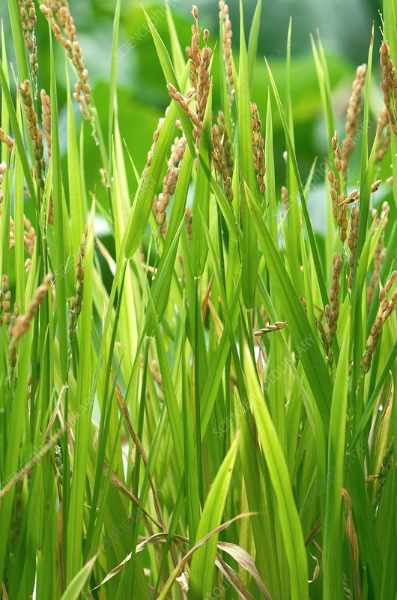
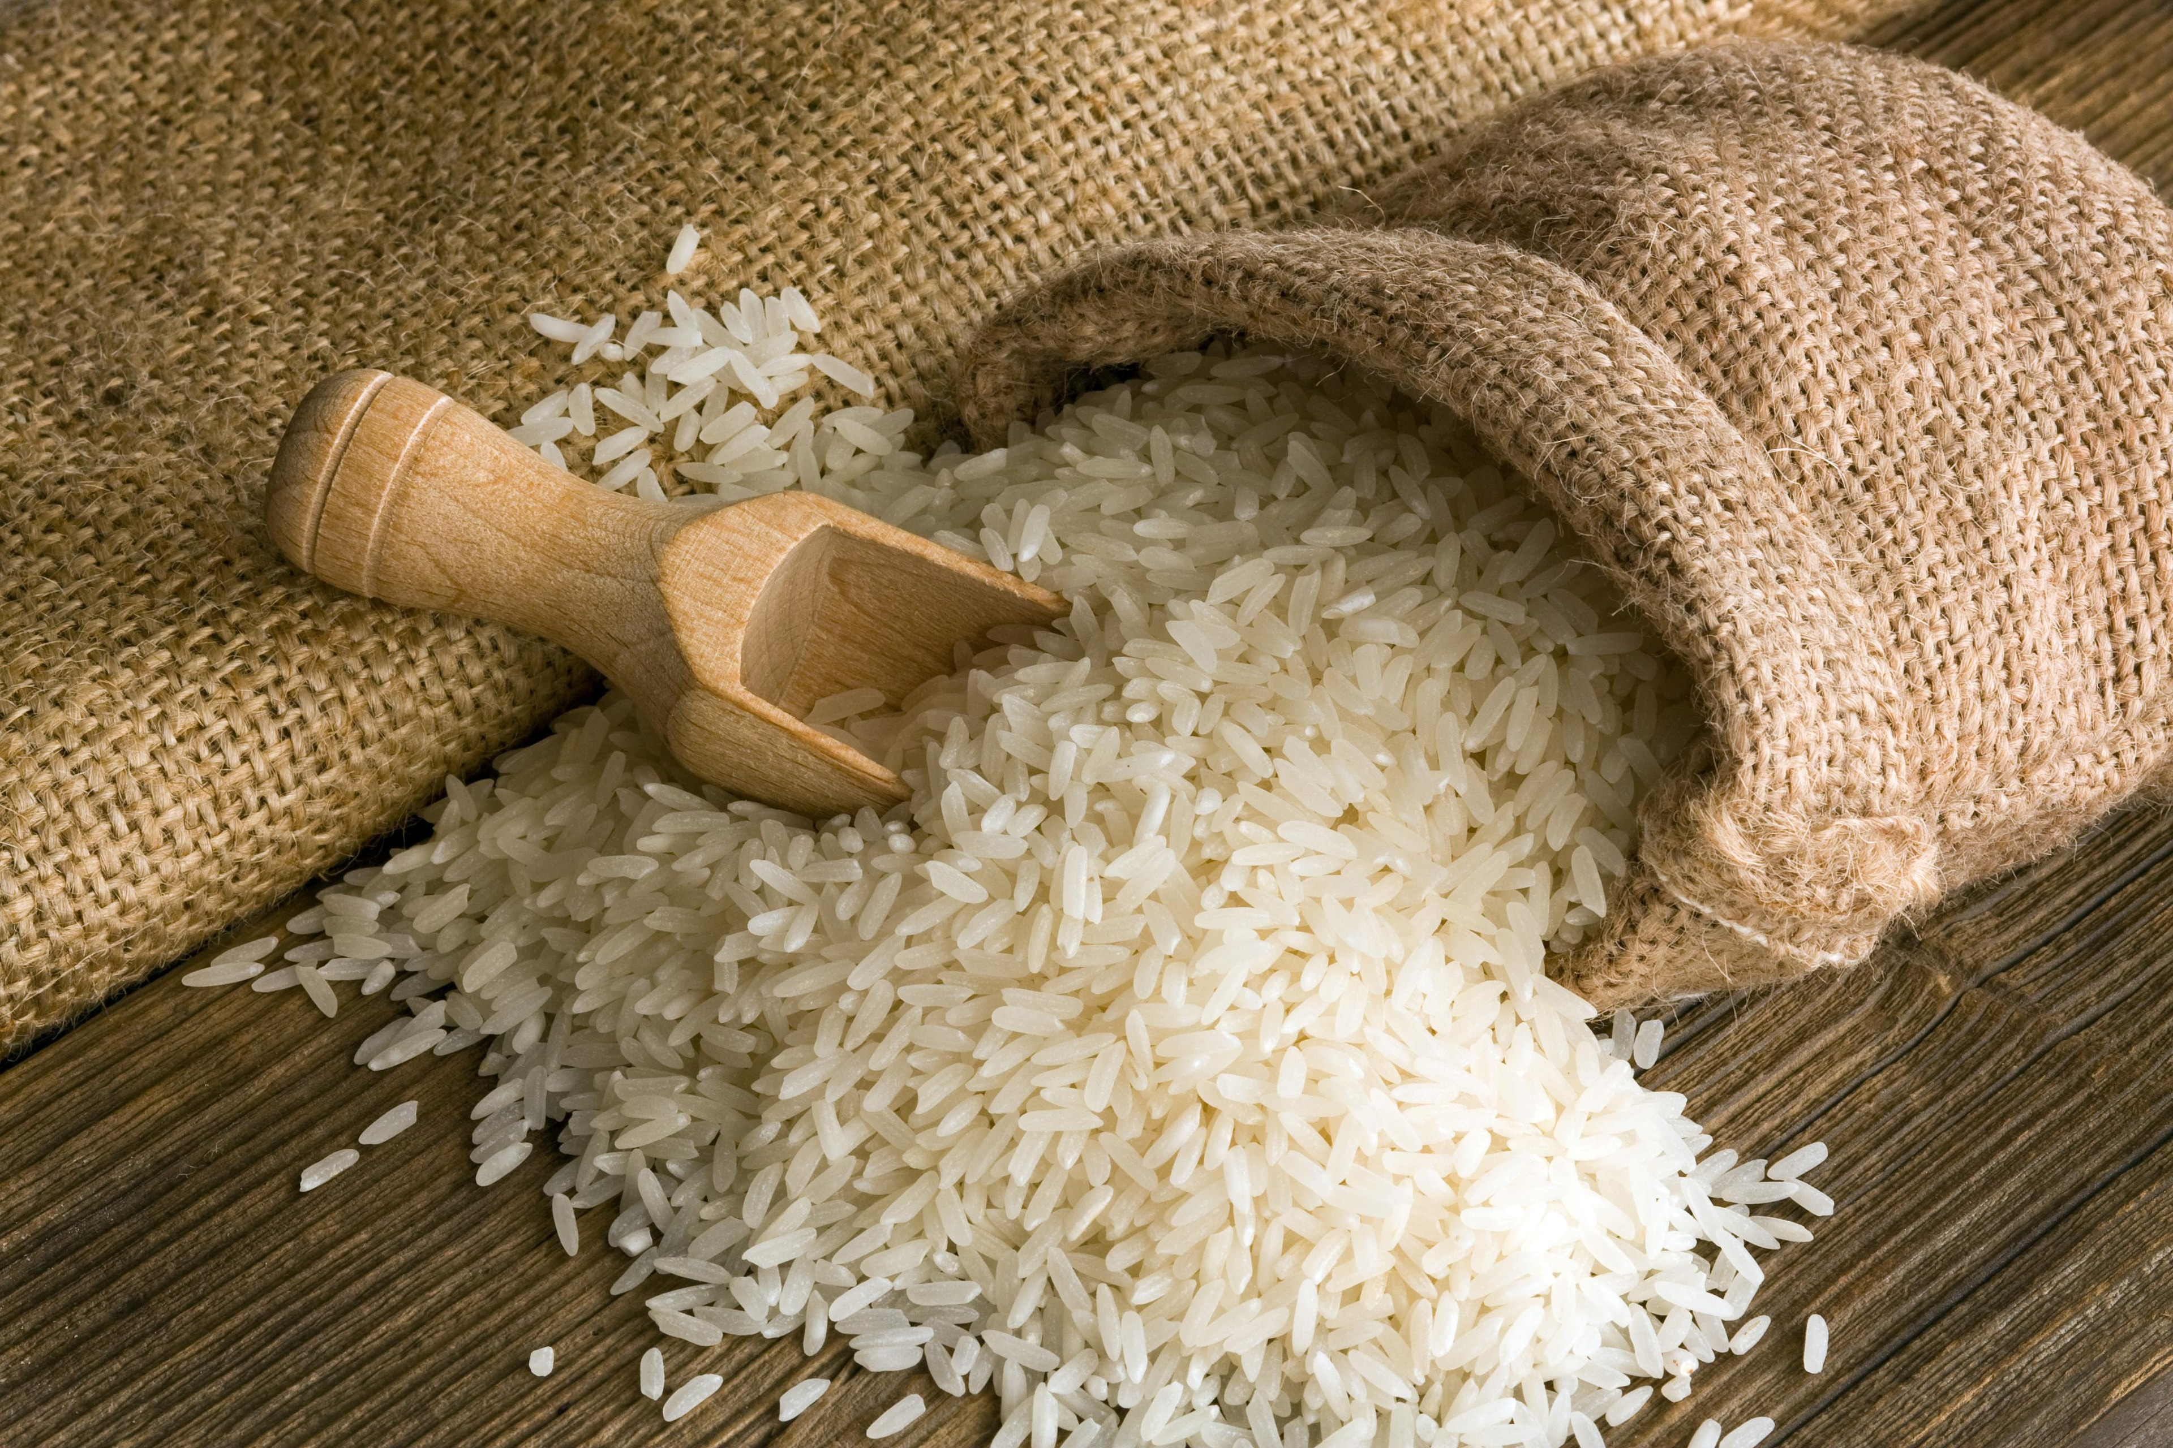
INTRODUCTION
Rice is a staple food and one the most popular crops worldwide.
Rice diseases impact the yield on a very large scale every year. Timely Detection of such diseases is necessary to reduce the impact and ensure healthy crops.
Our Objective is to develop a rice disease prediction model using deep learning that helps in the automatic of classifying rice diseases.
The objective can be achieved by using methods like Convolutional Neural Networks and Transfer Learning.

Slide 4

PROBLEM STATEMENT
Manual Identification of such diseases is quite difficult and challenging for the farmers and prone to human error.
Sometimes late predictions leads to huge loss.
To develop an automated, efficient and scalable deep learning-based system for accurately detecting and classifying rice plant diseases using rice leaf image data.

Slide 5
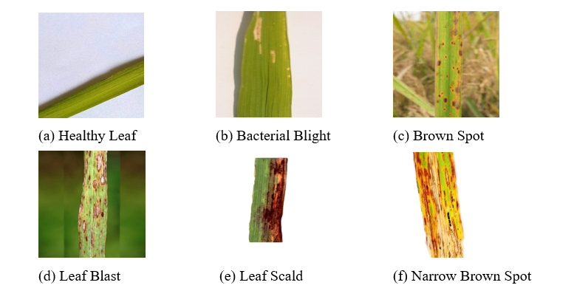
METHODOLOGY
DATASET
We have used a rice leaf disease dataset of around 2628 images which is divided into train and validation set and further classified into 6 classes each.

Slide 6
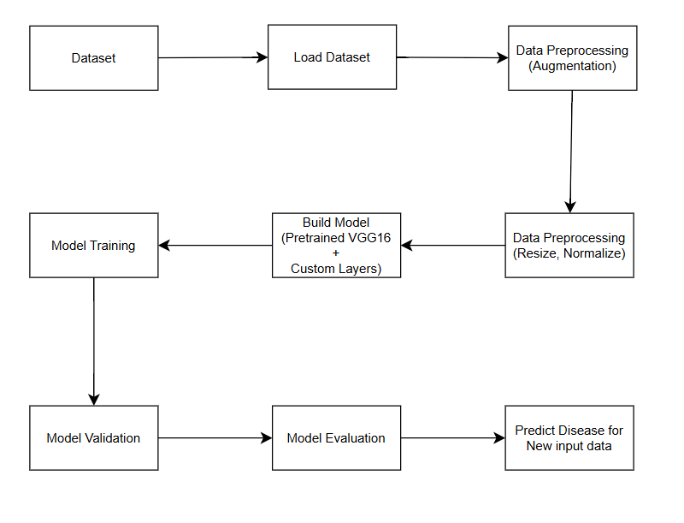
Block Diagram

Slide 7
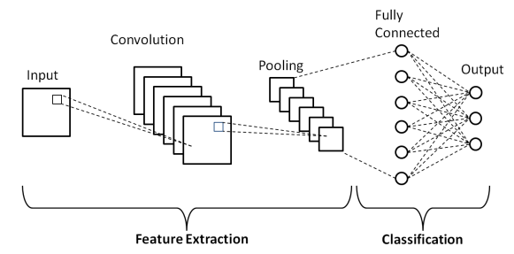
Data Preprocessing & Model Selection
Data Preprocessing
Data Augmentation(Training set): Rotation, flipping, shear, zoom and many more.
Normalization of Pixels to [0,1] for both training and validation sets.
Tools & Technologies
Languages: Python
Frameworks: TensorFlow, Keras
Models: Convolutional Neural Networks, Transfer Learning
Customized Model
Pretrained VGG16 model is used without fully connected layers.
Flatten layer, fully connected layer(with 512 neurons), dropout layer and output layer is added.
Adam optimizer is used for compilation with a learning rate of 0.0001.

Slide 8
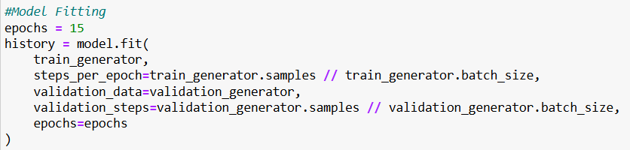
Model Fitting and Evaluation
Training Parameters
Batch Size= 32
Epochs=15
Performance Metrics
Validation Accuracy
Validation Loss
Prediction Function
Developed a test function to classify single images using the trained model.
Path of Images is used as input after resizing and normalization.

Slide 9
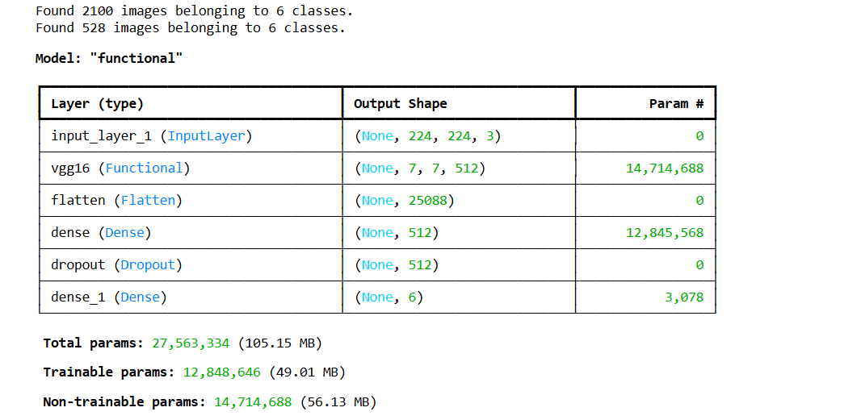
Result & Discussion
Model Summary
It provides a detailed overview of the model architecture.
Components
Layer Name
Layer Type
Output Shape
Number of Parameters
Total Parameter
Trainable Parameters
Non-trainable Parameters

Slide 10

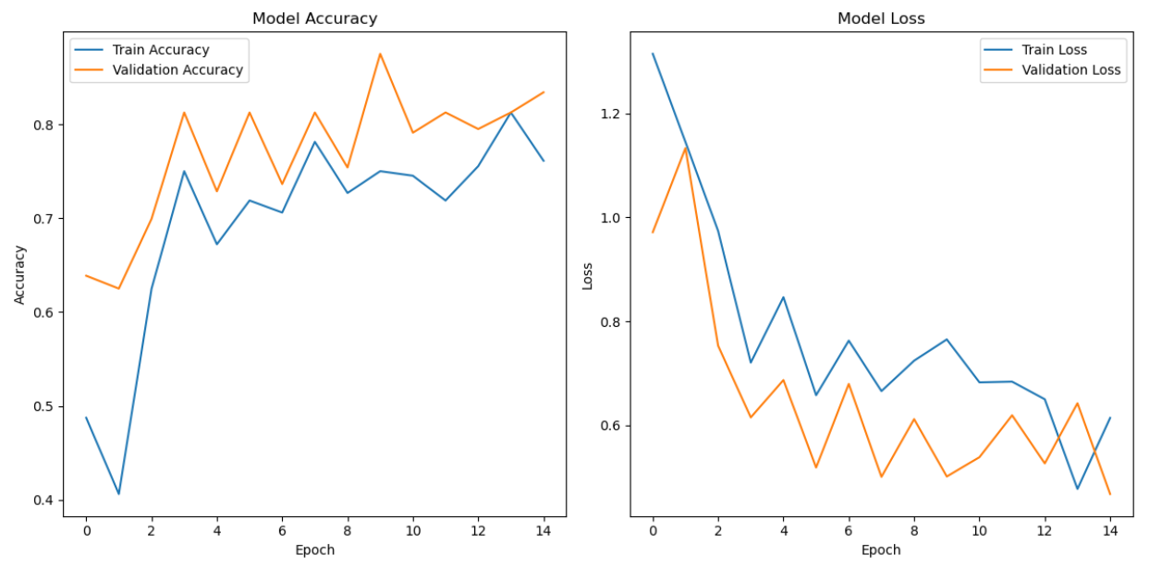
Result & Discussion
Performance Parameters
Validation Accuracy: 83%
Validation Loss: 46%

Slide 11
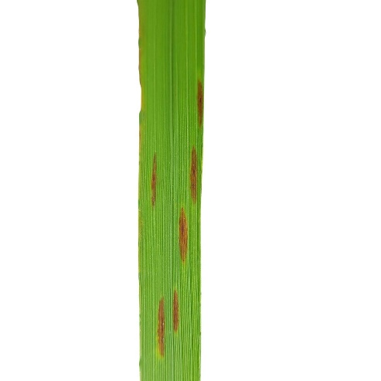
Result & Discussion
Prediction Function
This Function predicts the category of the given image
The path of image is given as input in the function
Image: Output:

Slide 12
Conclusion & Future Work
Conclusion
Successfully developed a rice plant disease prediction model using deep learning.
Prediction function predict the category of leaf images successfully.
This model offers a cost efficient and efficient way to get accurate solutions for timely detection of diseases.
Future Work
Generalization could be improved by testing on various datasets.
Real Time Data can be used to make it robust.
More Advanced Architectures can be used like MobileNet, Transformers, etc.
Multiple models can be combined to get higher accuracy.
Model Deployment can be done to get it connected with non technical users.
Make the model suitable for other crops also.

Slide 13
Thank you

